Slide 1

Stock price prediction
UNDER THE GUIDANCE OF DR.CHIRANJITH RAY
B23MCR01

Slide 2
GROUP MEMBERS
DASARI KARTHEEK (S20200010055)
MEESALA SARAN TEJA SUMANTH(S20200010125)
MARAPAKA BANNU DEEPAK(S20200010122)

Slide 3
INTRODUCTION
The prediction of stock groups values has always been attractive and challenging for shareholders due to its inherent dynamics, non-linearity, and complex nature
Many factors involved in the prediction – physical factors vs. physiological, rational and irrational behavior, investor sentiment, market rumors
All these aspects combine to make stock prices volatile and very difficult to predict with a high degree of accuracy
For a good and successful investment, many investors are keen on knowing the future situation of the stock market

Slide 4
INTRODUCTION [CONT…]
Almost every country has one or more stock exchanges, where the shares of listed companies can be sold or bought
When a company first lists itself in any stock exchange to become a public company, the promoter group sells substantial amount of shares to public as per government norms
In India the BSE(Bombay Stock Exchange) and the NSE(National Stock Exchange) are the two most active stock exchange. The BSE has around 5000 listed companies where as NSE has around 1600

Slide 5
PROBLEM STATEMENT
Predict the Closing price of a particular stock
Prediction should be mostly accurate with respect to the time
Predicting the Closing price of a particular stock based on the attributes like opening price, highest price, lowest price of the Past
Building a neural network model to predict Price of a particular Stock

Slide 6
MOTIVATION
As a key economic pillar the stock market has a significant impact on the development of business and industry, which has a significant impact on the overall health of the nation’s economy
The Stock market prices are likely to reflect the stock market prices are likely to reflect the same sentiment if the GDP is increasing and the economy appears to be improving, though not always in the short term
Economic Growth in countries is positively impacted by the stock market capitalization
Earning money or growing assets are very essential to get financial stability
Stock market is a place where everyone tries to earn money and grow their assets
But Majority of the population in India have no idea or they are not interested in Stock market
This can be because of several reasons like lack of awareness, fear, risk

Slide 7
MOTIVATION [CONT…]
Due to lack of financial knowledge or financial education people don’t involve themselves in growing or earning assets
For suppose if one want to invest their money in the stock market, one thing that inherits him is the risk factor and no idea how the price of a particular stock varies
The price of particular Stock varies on several factors depending on the company’s performance, their quarterly results, fake news spread by people etc
So we need to estimate or predict the price of a particular stock based on the data which was recorded in all kinds of situations.
And make people to get profits from their investments and reduce the loss.

Slide 8
OBJECTIVE
Our Main Objective to build a neural network model which can predict the price of a particular stock over a period of time.
We are going to use the Deep Learning concepts we can come up with designing a system to predict the price of particular stock according to its opening, closing, highest, lowest price over a period of time for a particular stock
We are going to build a model (hybrid model i.e combination of different neural network models) which gives much more accurate results than the models described in the literature review

Slide 9
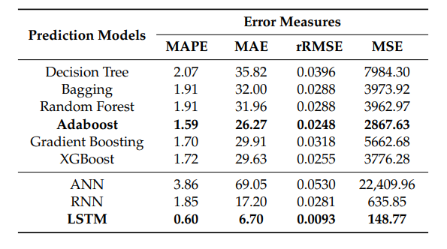
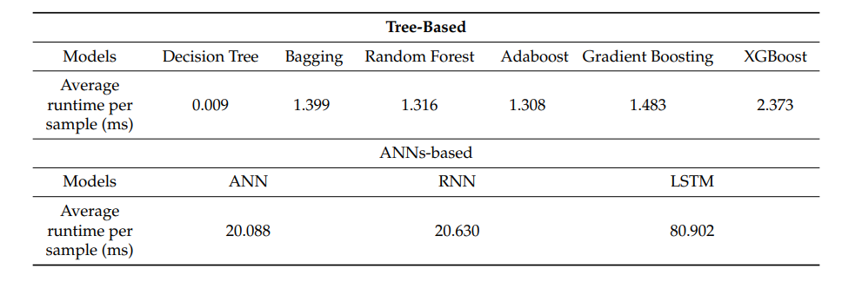
LITERATURE REVIEW
Mojtaba, Pooyan, Hamed [1] explains the various models for predicting the price of a particular stock
This includes the decision tree, random forest and artificial neural networks(ANN), recurrent neural network (RNN) and long short term memory (LSTM)
Deep neural networks were superior and has given the accurate results
We Consider this Paper as the base and justifies to procced with the neural network models for the stock price prediction

Slide 10
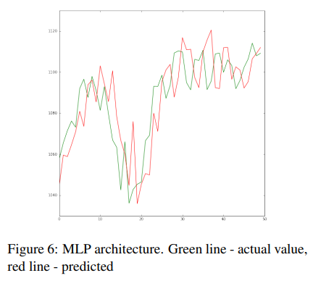
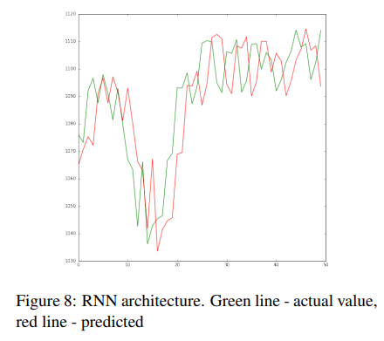
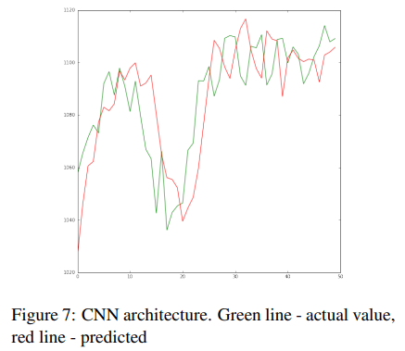
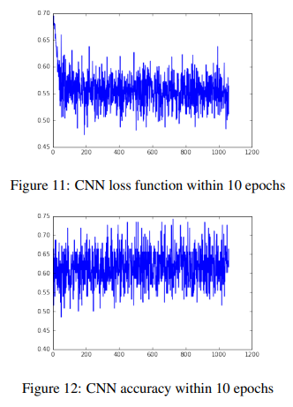
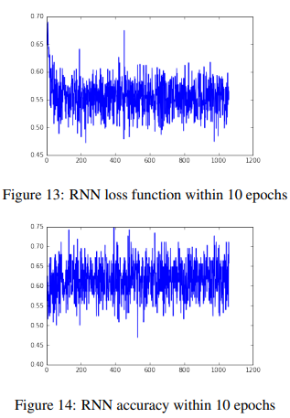
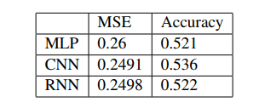
LITERATURE REVIEW
Luca Di, Oleksandr[2] considers 3 models they are Multi-Layer Perceptron(MLP), Convolutional Neural Networks(CNN) and Long Short Term Memory (LSTM)
And Compares the Results give these three models by passing the required inputs to the models.
And in this paper they concluded that the CNN models are best choice for modelling financial time series data as the data that we are going to process is time series data

Slide 11
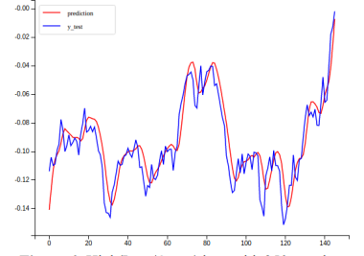
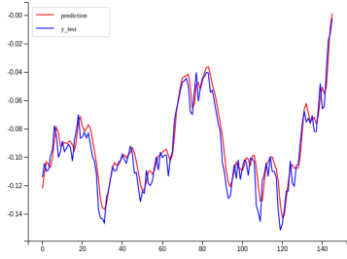
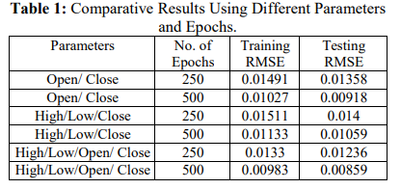
LITERATURE REVIEW
Murtaza, Harshal, shraddha [3] In this paper they used LSTM model for predicting the Stock prices.
Long short term memory is one of the most successful RNN architectures it consists a memory cell which is a unit of computation that replaces the traditional artifical neurons in the hidden layer of the network
With these memory cells, networks are able to effectively associate memories and input remote in time, so that it can grasp the patterns dynamically over time with high prediction capacity and have given good accurate results

Slide 12
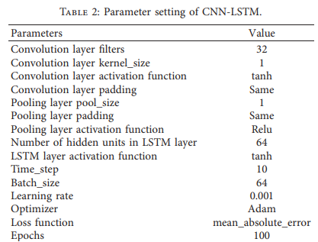
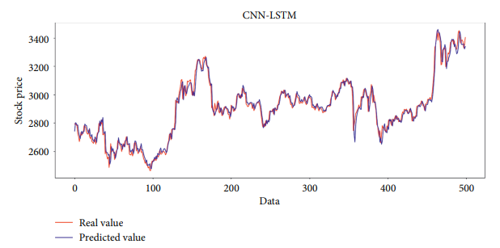
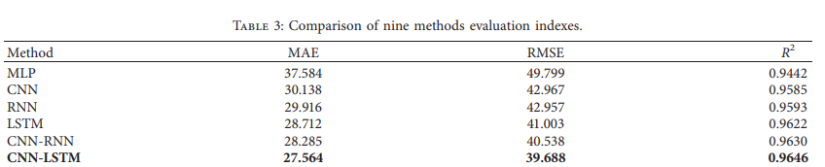
LITERATURE REVIEW
In [6] proposed a stock price prediction model based on CNN-LSTM for the stock closing price of the next day forecasting
CNN is used to extract the features of the input timeseries data and LSTM used for data forecasting

Slide 13
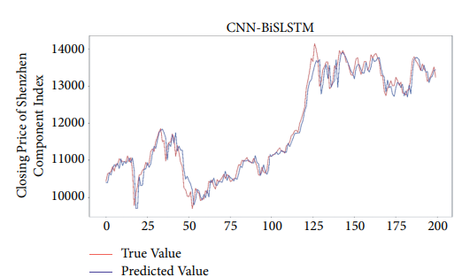
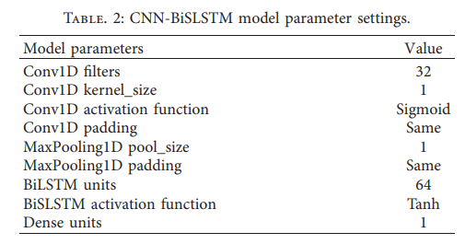
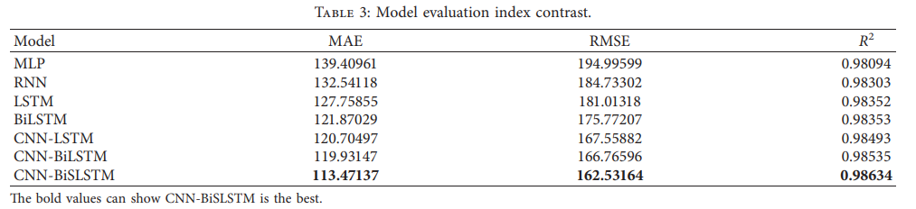
LITERATURE REVIEW
In [7] proposed a stock prediction model based on CNN-BISLSTM which uses stock data of last five trading days and predicting the closing price of the next trading day.
CNN is used to extract the characteristics of stock data, and BiSLSTM is used to predict the stock closing price.

Slide 14
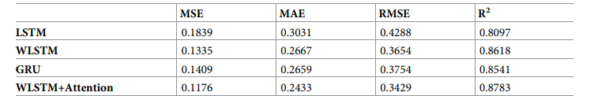
LITERATURE REVIEW
In [8] proposed a model using LSTM with attention mechanism.
Attention Mechanism is applied in stock forecasting mainly through the extraction of information in the news in an auxiliary role to judge price fluctuations.
Uses soft attention mechanism which is more efficient to use the input information and obtain the result in a timely manner.
Output of LSTM hidden layer passed to the input of the attention mechanism.

Slide 15
PROPOSED APPROACH
The CNN Layer is used to extract local features from the stock price time series.
And then the extracted features are then passed to the BiLSTM layer with SLSTM cells.
The Attention Mechanism can help the model to focus on important parts of the input sequence and learn the correlations between different time steps
So the Attention Mechanism is then applied to the output of the BiLSTM layer with SLSTM cells which produces a weighted representation of the input sequence based on the importance of each time step.
So we can combine these models so that we can use the time sequence of stock price data to obtain more reliable forecasting
Basically we are going to build a model based on the short term dependencies Such as investor sentiment, news events and changes in trading volume and long term dependencies such as moving averages etc.
CNN is suitable to capture the short term dependencies and fluctuations
BISLSTM with Attention Mechanism are popular because of the ability to handle sequential data and capture Long term dependencies
We are going to build a Hybrid model for the stock price prediction

Slide 16
PROPOSED APPROACH (MODEL)
CNN BISLSTM-AM
CNN
BISLSTM WITH AM
To handle the short term Dependencies
To handle the Long term Dependencies

Slide 17
IMPLEMENTATION

Slide 18
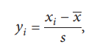
DATA PREPROCESSING
First Need to Pre-process the data and then pass it into the Model
Use Date as Index
Replace the Null values with the mean of the column
Normalize the data (Z-Score Normalization)
Need to Reshape the data to pass into the model
Split the data as Training, Validation, and Test
Input Shape for the data that need to be passed into the model must be in the form (Batch Size, Sequence Length, No of Features)
Sequence Length =7 (7 Days )
No of Features =6 (Open, High, Low, Close, Volume, Adj close)

Slide 19
DATA PREPROCESSING
Creating Sequential Data with the input data and the Sequence Length
Dimensions of the Sequential Data (Sequence Length, Number of Features) =>(7,6)
Batch of Data is loaded Using the ‘DataLoader’ Object, Now Each Batch will have a Shape of (Batch Size, Sequence Length, Number of Features)
Now Each Batch is passed through the Model

Slide 20
MODEL ARCHITECTURE (BASIC)
Conv1d with Batch size 64, input features(input channels) 6, filters 32, Kernel size 1
(64,6,7) Input Shape to the Conv1d
Activation Function Sigmoid for CNN Layer (64,32,7)
MaxPool Layer with Kernel Size 1 (64,7,32)
BILSTM Layer with Input Size=32, Hidden Size=128,num_layers=2
Activation Function Tanh for BILSTM Layer (64,7,256)
Dense Layer Linear Function with 2*Hidden Size (64,1) -> Output shape
MAE as Loss Function, Adam Optimizer, Learning Rate=0.0001

Slide 21
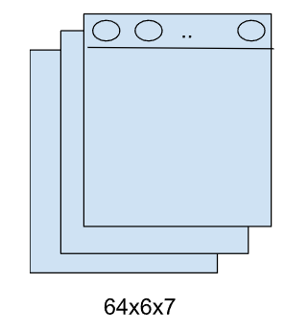

MODEL ARCHITECTURE
POOLING LAYER
CNN LAYER
CONVOLUTIONAL LAYER
Input sequence data
FORWARD LSTM LAYER
LSTM
LSTM
LSTM
LSTM
BILSTM LAYER
…
LSTM
LSTM
LSTM
LSTM
BACKWARD
LSTM LAYER
ATTENTION MECHANISM LAYER
OUTPUT

Slide 22
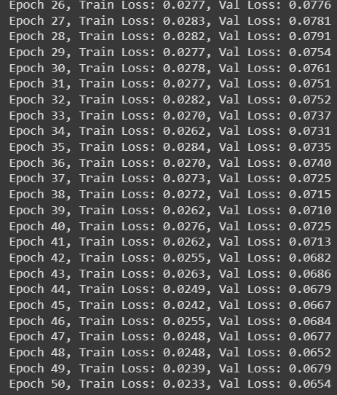

RESULTS

Slide 23
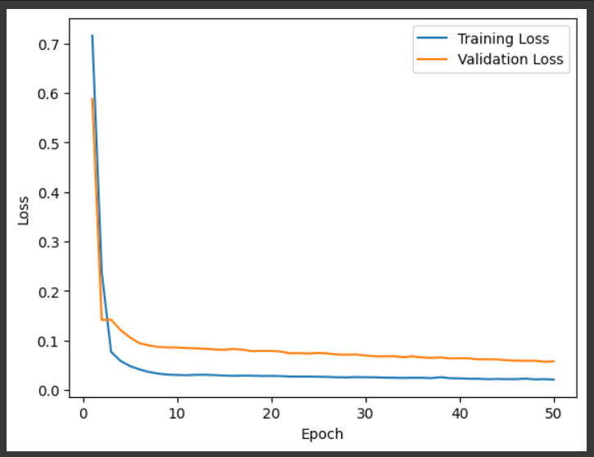
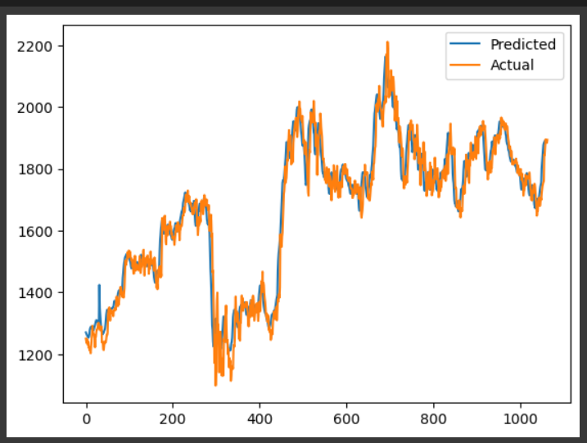
RESULTS

Slide 24
CHALLENGES
We have Pre-processed the Data, Now need to Build the Model
Not a Single Model, Hybrid Model
Need to carefully Handle each Layer’s output and pass it to the next Layer without any issues.

Slide 25
FUTURE WORK
For now we have implemented the Model using CNN-BILSTM only
Need to Add Attention Mechanism
Optimizing the Model for Better Results

Slide 26
ROADMAP (TENTATIVE)
Review 1
LEARNING AND DATA GATHERING
Review 2
BUILDING MODEL
Review 3
TESTING,OPTIMIZATION
Review 4
A WEBAPPLICATION

Slide 27
AVAILABLE DATASETS
Yahoo Finance
In this website we can get the previous data of any stock that we want which consists the date open, close, high, low, volume as attributes.
Kaggle
From Kaggle we can get the previous data of the NIFTY 50 stocks and details of other stocks

Slide 28
REFERENCES
Mojtaba, Pooyan, Hamed, Deep Learning for stock market Prediction. Entropy 2020,22
Luca Di, Oleksandr, Artificial Neural Networks architectures for stock price prediction: comparisons and applications. Trace 2016,10, 403-413
Murtaza, Harshal, Shraddha Predicting Stock Prices Using LSTM. IJSR 2017
Sidra, Jayadip Stock Price Prediction Using Convolutional Neural Networks on a Multivariate Time Series. . IEEE 2020
Yahoo Finance Available online www.finance.yahoo.com
Wenjie Lu, Jiazheng Li, Yifan Li, Aijun Sun, A CNN-LSTM-BASED Modelto Forecast Stock Prices.Complexity,vol 2020, Article ID 6622927, 10 pages
Wang H, Wang J, Cao L, Li Y, Sun Q,& Wang, J. (2021). A Stock Closing Price Prediction Model Based on CNN-BiSLSTM. Complexity, vol 2021, Article ID 5360828,12 pages.
Qiu, J., Wang, B., & Zhou, C. (2020). Forecasting stock prices with long-short term memory neural network based on attention mechanism. PLoS ONE, 15(1), e0227222.

Slide 29
THANK YOU

